Slide 1
AWS Overview
Karthick Selvam

Slide 2
AWS Overview
Introduction to AWS, Usage, core concepts such as elasticity, scalability, virtualization
IaaS, PaaS, SaaS
VPC, Subnet, Security Group, NACL, NAT Instance
Overview of DW and Data Lake related services, such as, EMR, Glue, Redshift, Athena
Region, Availability Zone, Edge Locations
IAM user, roles, policies

Slide 3
Virtualization
Karthick Selvam

Slide 4
Topics
What is Virtualization?
Why we need the Virtualization?
Advance concepts of Virtualization?

Slide 5
General Questions
How the System Booting Process will happen?
Why we cant able to boot 2 OS at the Single Hardware?
What is BIOS?
What is Boot Sector?
How system will work after the booting process?

Slide 6
BIOS
BIOS is the program a computer microprocessor uses to start the computer system after it is powered on.
It also manages data flow between the computer OS and attached peripheral devices

Slide 7

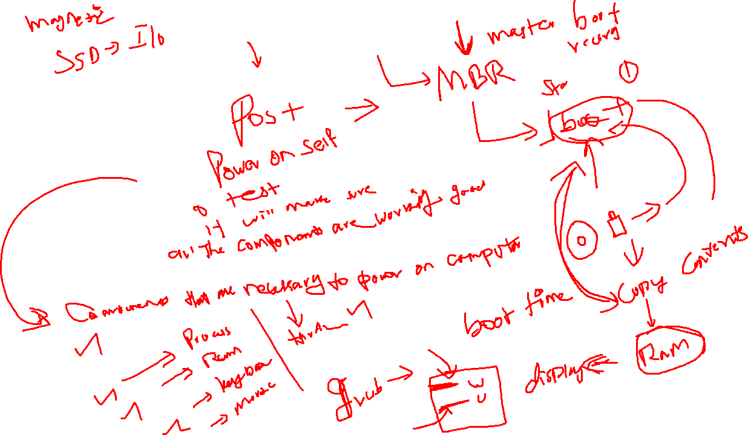

Slide 8
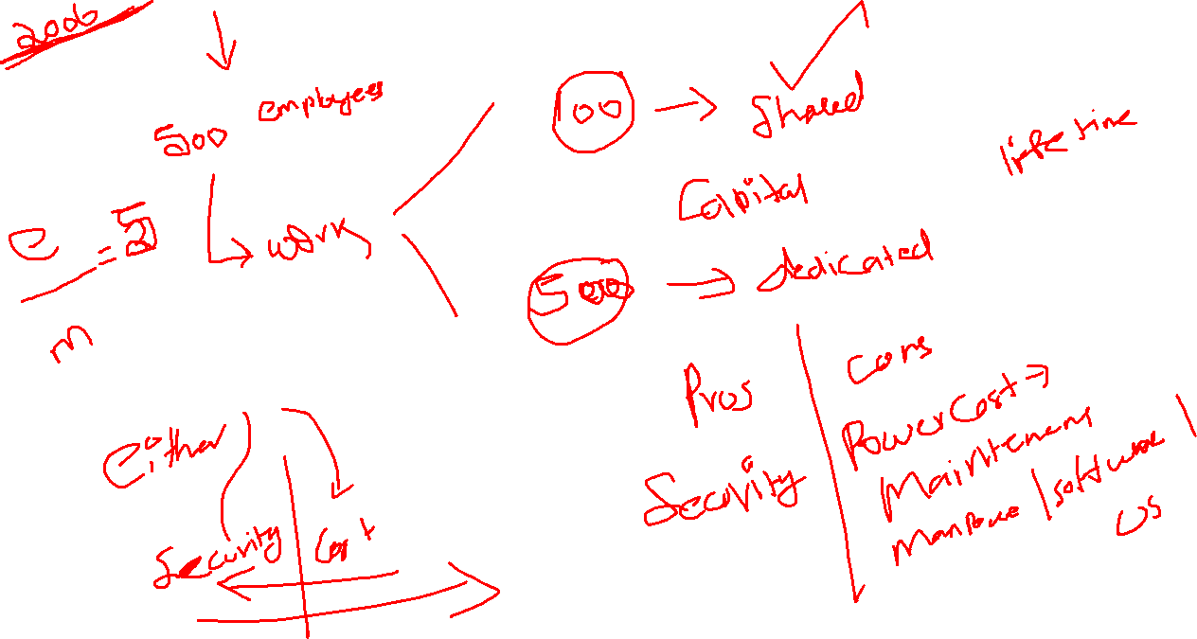
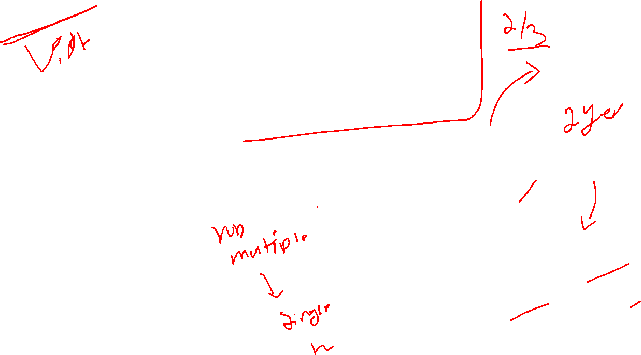

Slide 9
Virtualization
Environment -> your hardware resources into software components and make it manage to install multiple OS at the same time in the Single hardware
Concept of Creating the Software based Fake environment to make the OS to trust all the resources that will be physically available and boot the Multiple OS at the same time.

Slide 10
Types of Virtualization
TYPE 1
TYPE 2

Slide 11
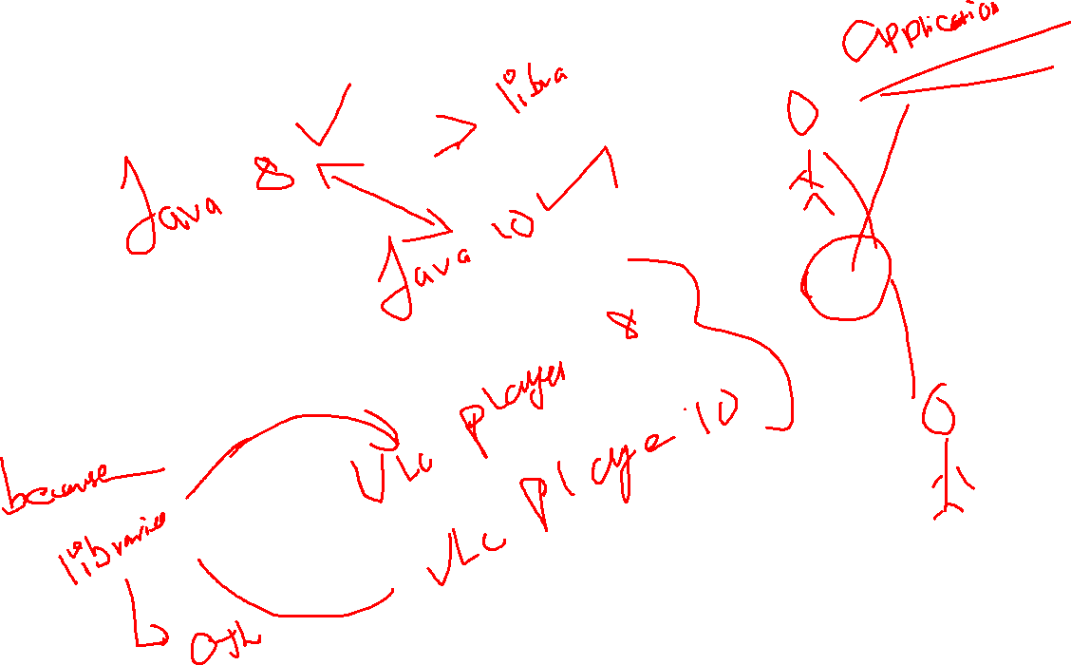

Slide 12
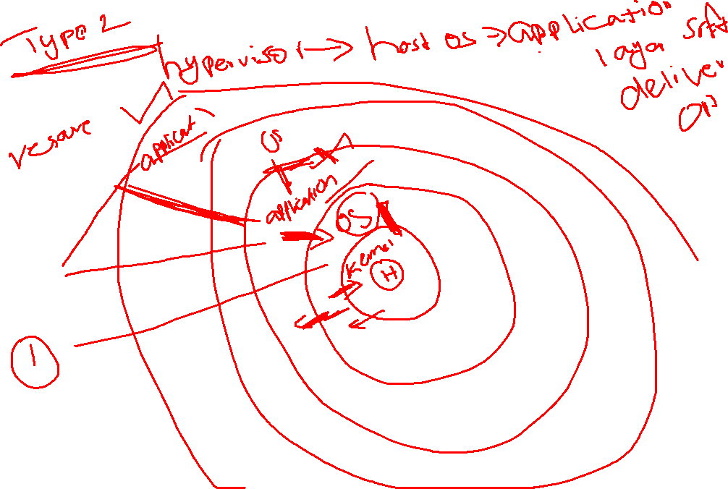

Slide 13
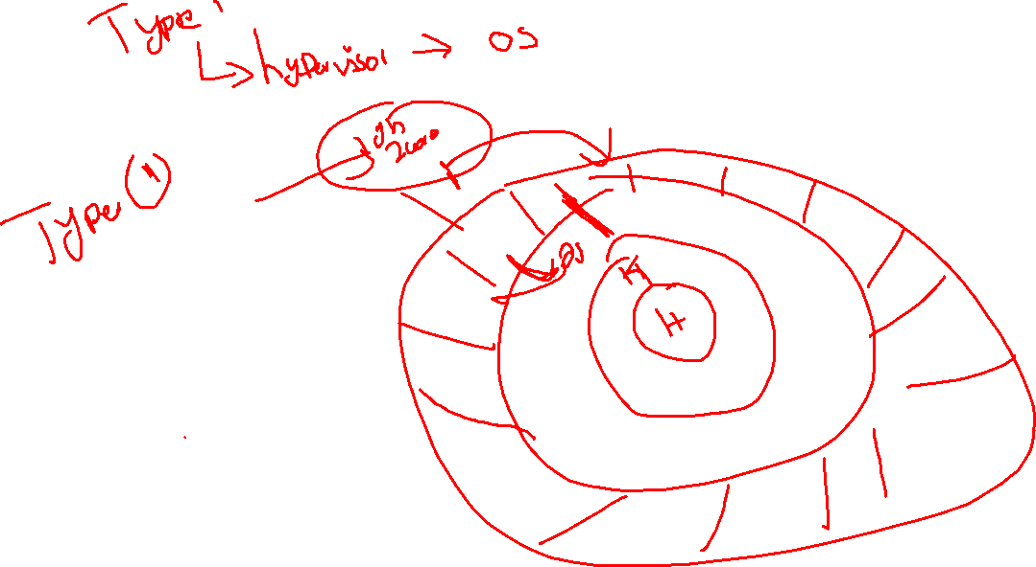

Slide 14
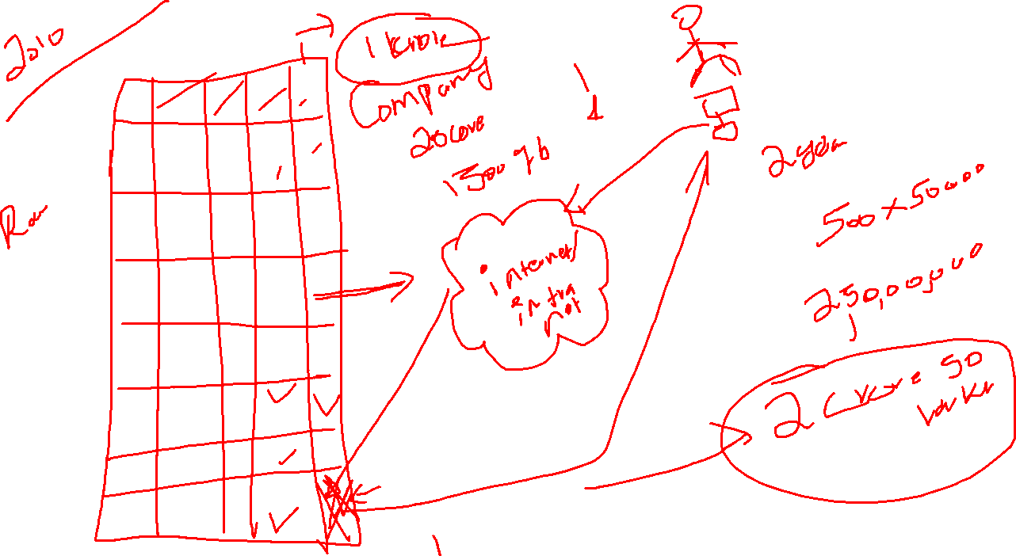

Slide 15
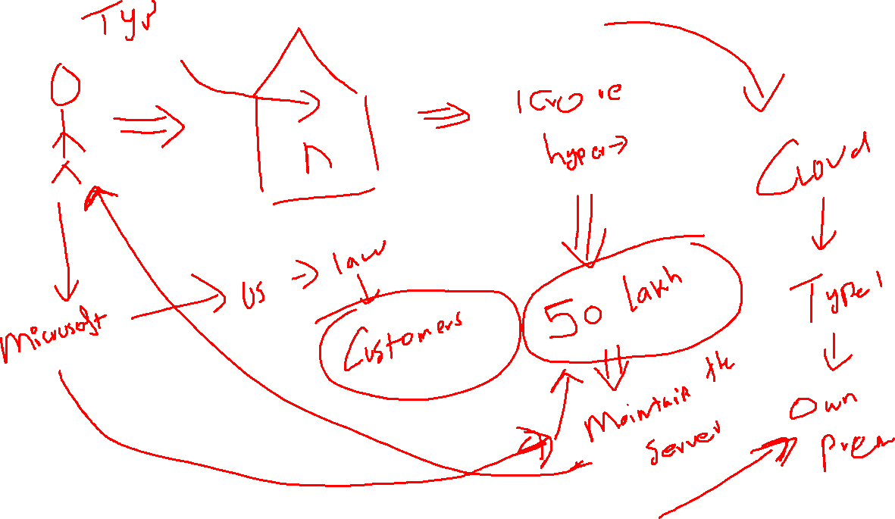

Slide 16
Break time -> 04.30

